Slide 2
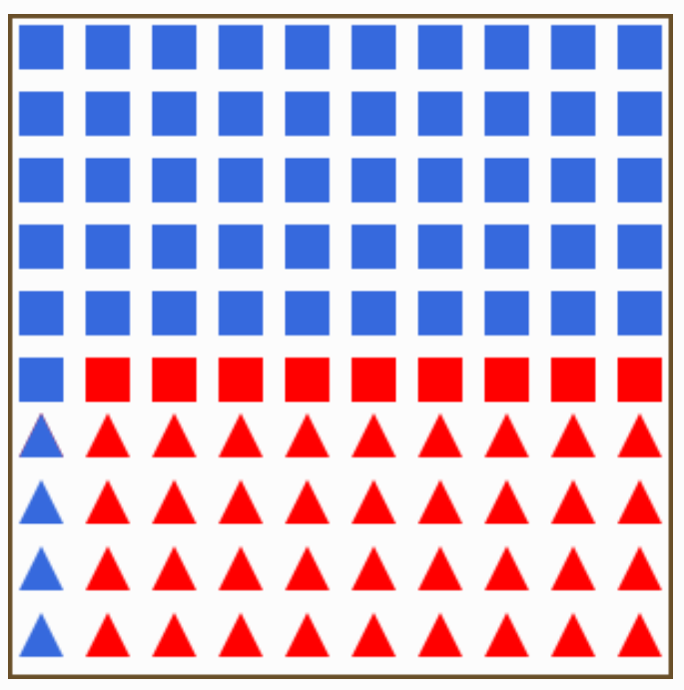
Logique Bayésienne
Rouge=retard>1h P(r<1h)=55%
Bleu = retard <1h P(r>1h)=45%
Carré=Swiss P(Swiss)=60%
Triangle=Easyjet P(Easyjet)=40%
Intuitivement: P(r>1h|Easyjet)=36/40=90%
Bayes: P(r>1h|Easyjet)=P(Easyjet|r>1h)*P(r>1h)/P(Easyjet)) =36/45 * 45 / 40 = 36/40 = 90%

Slide 3
Logique Bayésienne multivariée
Rouge=retard>1h P(r<1h)=55%
Bleu = retard <1h P(r>1h)=45%
Carré=Swiss P(Swiss)=60%
Triangle=Easyjet P(Easyjet)=40%
Fond blanc = départ le matin P(matin)=70%
Fond bleu = départ l’après-midi P(après-midi)=30%
Intuitivement: P(r>1h|Easyjet, matin)=24/28=86%
Bayes: P(r>1h|Easyjet, matin) =
P(Easyjet, matin|r>1h)*P(r>1h)/P(Easyjet, matin)=24/45 * 45/28=24/28=86%

